Slide 1


2022 Pointe Coupee Parish
Hazard Mitigation Plan Update
Kick Off with OHSEP

Slide 2
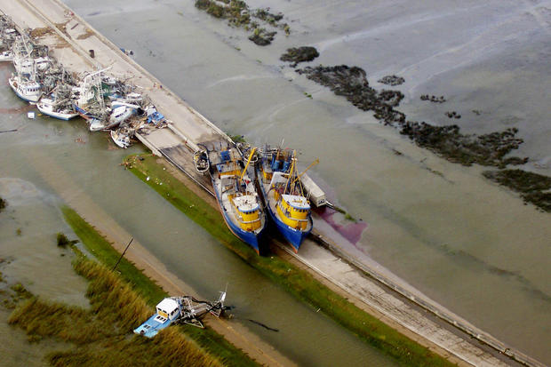
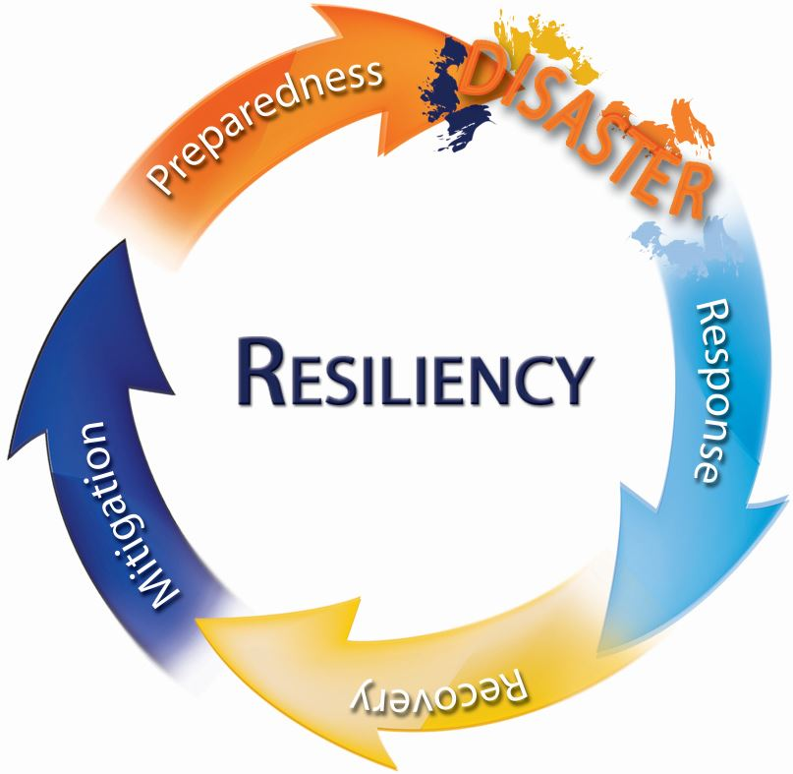
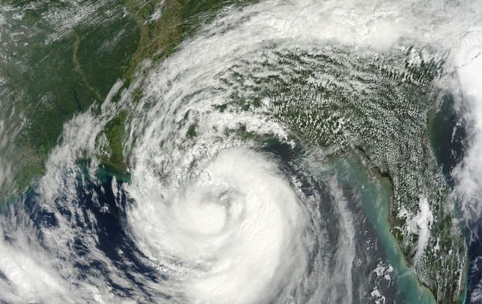
The Hazard Mitigation Plan:
What is in it for us?

Slide 3
Hazard Mitigation Is…..
Any action taken to reduce long term risk to life and property;
On-going process that occurs before, during, and after disasters;
Mitigation actions help prevent damage to a community’s infrastructure, economic, cultural and environmental assets;
Minimize operational downtime and accelerate recovery of government and the private sector after an event;
Implementation of mitigation actions leads to building stronger, safer and smarter!
Notes:
It is estimated that for every $1 invested, an average of $6 is saved long term
Mitigation is actually the first step in the disaster cycle – followed by preparedness, response and recovery. It is often overlooked and should not be. Mitigation is a critical step that can break the cycle and reduce losses after a disaster.

Slide 4
Why Do We Have A
Hazard Mitigation Plan?
To meet federal requirements.
Planning efforts help our communities become more sustainable and disaster-resistant by focusing efforts on the hazards, disaster-prone areas and identifying appropriate mitigation actions for future projects.
Must have a plan as a condition for receiving certain types of non-emergency disaster assistance.
No Plan = No Mitigation Money = No Project funding.

Slide 5
Hazard Mitigation Plan
Update Requirements
The plan must be updated every five (5) years;
Must have representation from each incorporated jurisdiction in the parish.
Approved plan must be on file with FEMA to receive any federal hazard mitigation funds in the future.
Approved plan must be on file with FEMA to utilize already allocated federal hazard mitigation funds on current projects.
Must follow the FEMA update process (facilitated by GOHSEP and LSU).

Slide 6
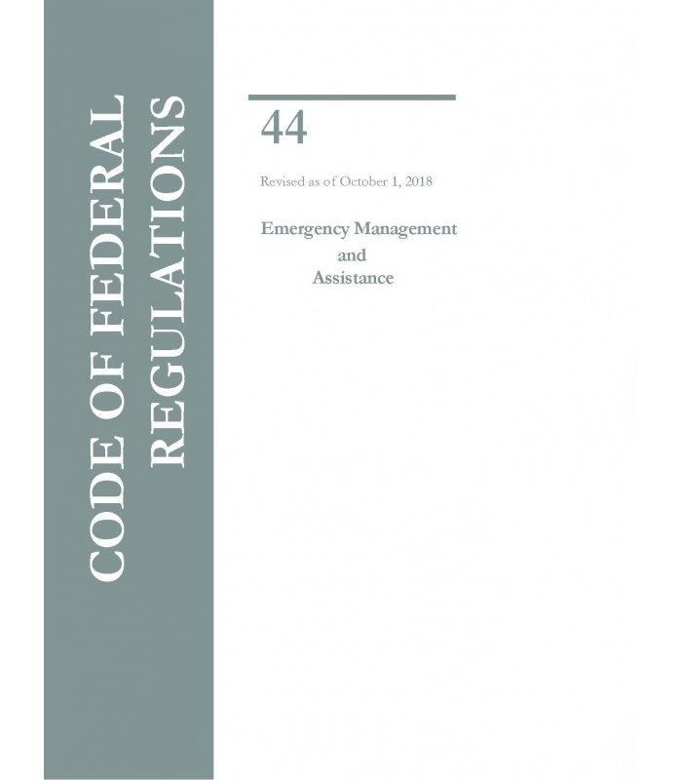
Federal Requirements
Disaster Mitigation Act of 2000 (DMA 2000)
  Section 322 of the Act specifically addresses mitigation planning and requires state and local governments to prepare multi-hazard migration plans as a precondition for receiving FEMA mitigation project grants.
Title 44 Code of Federal Regulations (CFR) §201.6 for FEMA approval and eligibility to apply for FEMA Hazard Mitigation Assistance

Slide 7
The Planning Team: A Multi-jurisdictional Approach
Each jurisdiction will have one representative on the planning team.
  This representative will need to gather data requested by the planning team, collect feedback and input into the plan.
Each jurisdiction is responsible for gathering NFIP, Capability Assessment, Critical Facilities and vulnerable population data for the plan.
Each jurisdiction is responsible for updating mitigation actions and proposing new actions for the update.

Slide 8
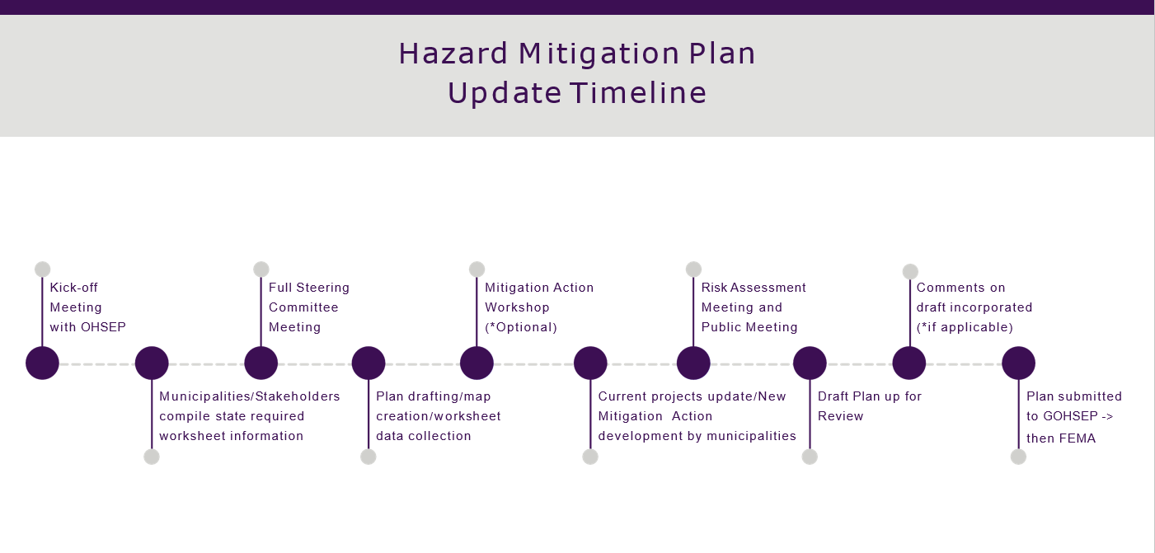

Slide 9
Plan Adoption
Each jurisdiction MUST adopt the final plan one it is approved by FEMA
As a planning team member be aware of the policies for your jurisdiction
  Know the process for putting this plan on the docket for adoption

Slide 10
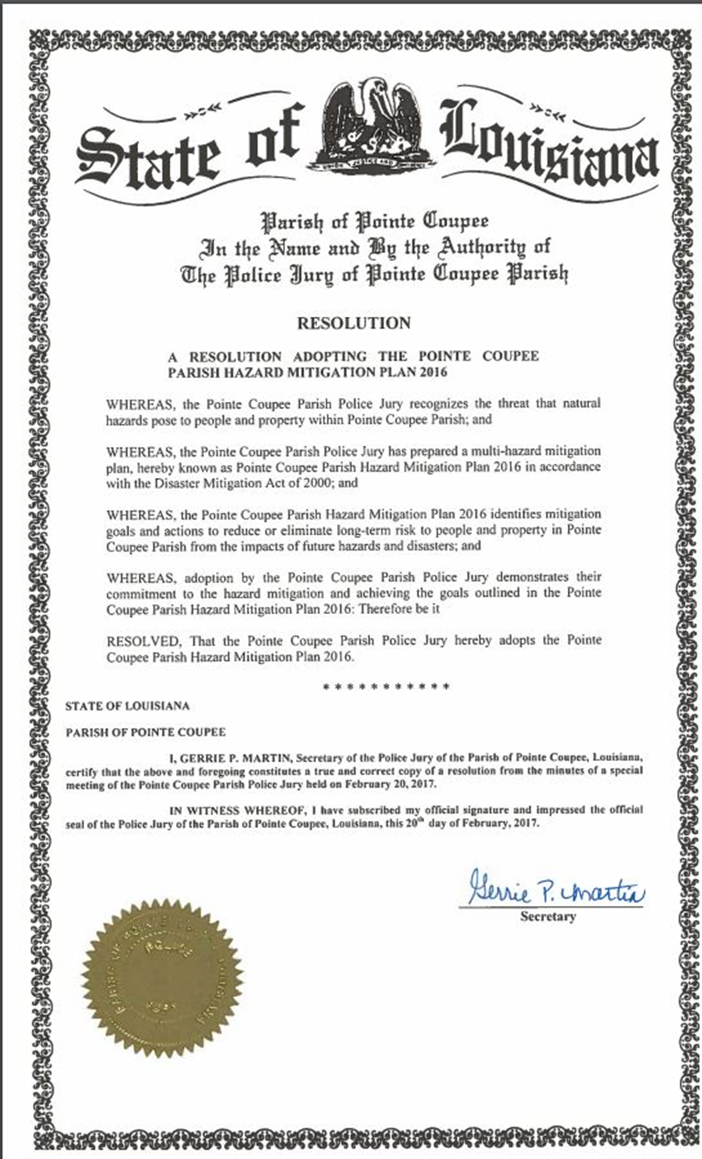
Plan Adoption
Parish council and city council resolutions must be adopted, signed, and placed into the final planning document.

Slide 11
The Final Product
FEMA approved Hazard Mitigation Plan
  Meets requirements of Title 44 Code of Regulations (CFR) §201.6 for approval and eligibility to apply for FEMA Hazard Mitigation Assistance grant programs.
  A hazard mitigation project strategy for each jurisdiction
  A comprehensive list of jurisdiction owned properties
  Assessment of natural disaster-related risks and vulnerabilities

Slide 12
Next Steps
Planning Committee Selection
  At least one representative from each jurisdiction
Neighboring Community Selection
  FEMA requirement
Initial Planning Committee Meeting Date
Parish/OHSEP Logo

Slide 13


