Slide 1



St. James Parish
Hazard Mitigation Plan Update
June 29, 2021

Slide 2
Introductions
St. James OHSEP and Parish Officials
Mitigation Steering Committee Members
SDMI
GOHSEP

Slide 3

Who is SDMI?
Stephenson Disaster Management Institute (SDMI) at Louisiana State University
Non-Academic, Applied Research Unit on campus under the SNCSRT umbrella.
Founded by Toni and Emmet Stephenson
Notes:
Explain here how SDMI become involved in this project.

Slide 4
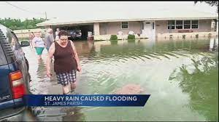
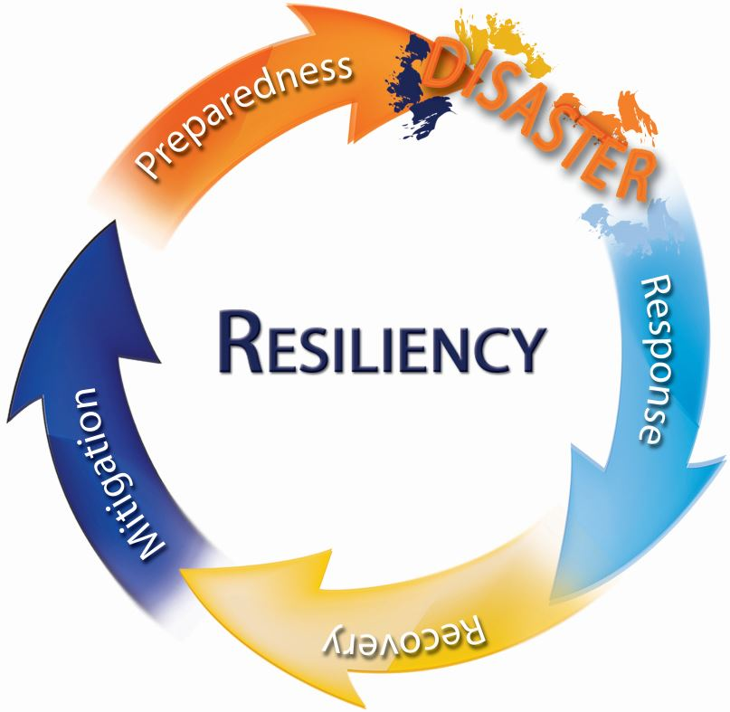
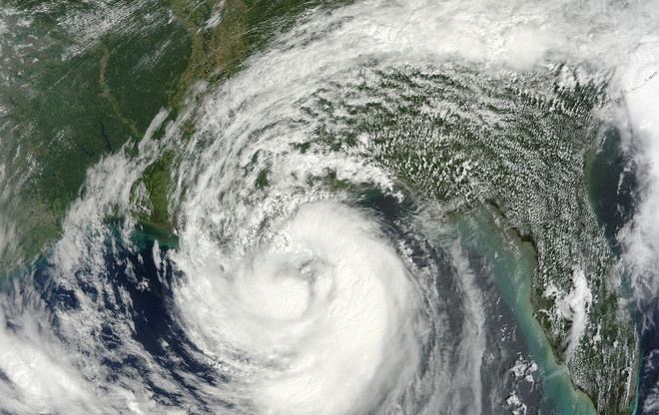

The Hazard Mitigation Plan:
What is in it for us?

Slide 5
Hazard Mitigation Is…..
Any action taken to reduce long term risk to life and property;
On-going process that occurs before, during, and after disasters;
Mitigation actions help prevent damage to a community’s infrastructure, economic, cultural and environmental assets;
Minimize operational downtime and accelerate recovery of government and the private sector after an event;
Implementation of mitigation actions leads to building stronger, safer and smarter!
Notes:
It is estimated that for every $1 invested, an average of $6 is saved long term
Mitigation is actually the first step in the disaster cycle – followed by preparedness, response and recovery. It is often overlooked and should not be. Mitigation is a critical step that can break the cycle and reduce losses after a disaster.

Slide 6

Planning Process

Slide 7
Hazard Mitigation Plan Update
Requirements
The plan must be updated every 5 years
Re-assess hazard identification and risk assessment
  Consider any changes since the last plan update, and address events that have occurred since the last plan;
Incorporate local planning efforts;
Report mitigation strategy (projects) progress and discuss adjustments;
Must be multijurisdictional
Notes:
plan is due for approval by March 2016
Incorporate local planning efforts –

Slide 8
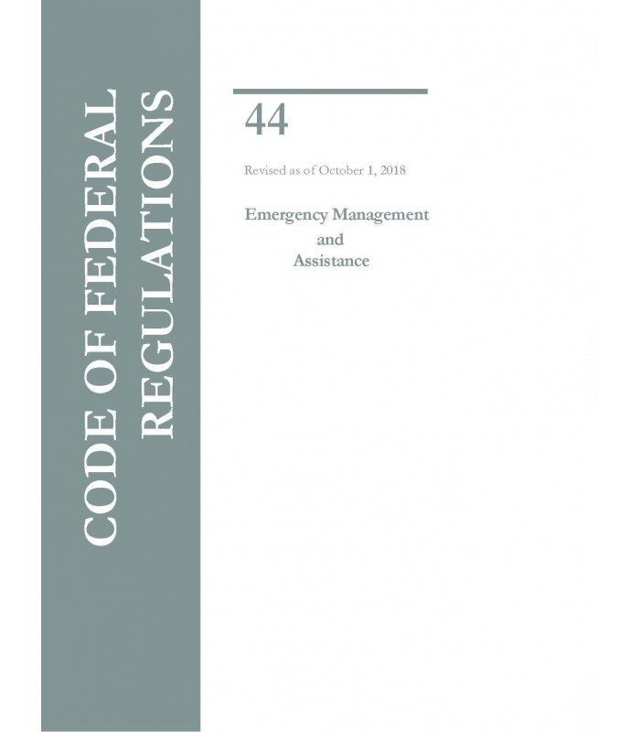
Federal Requirements
Disaster Mitigation Act of 2000 (DMA 2000)
  Section 322 of the Act specifically addresses mitigation planning and requires state and local governments to prepare multi-hazard migration plans as a precondition for receiving FEMA mitigation project grants.
Title 44 Code of Federal Regulations (CFR) §201.6 for FEMA approval and eligibility to apply for FEMA Hazard Mitigation Assistance

Slide 9


Expectations of the Planning Committee
Parish will serve as the main liaison/POC throughout the planning process
Each jurisdiction MUST show active participation in the planning process by the following:
  Completing state required worksheets;
  Identifying and updating jurisdiction specific mitigation actions (projects);
  Have representation at meetings;
  Report to community and gather feedback from appropriate agencies;
  Adopt the final plan.
Notes:
These expectations are requirements by FEMA for the planning process to be approved. If they do not participate the will not be eligible for mitigation grant funds through this process.

Slide 10
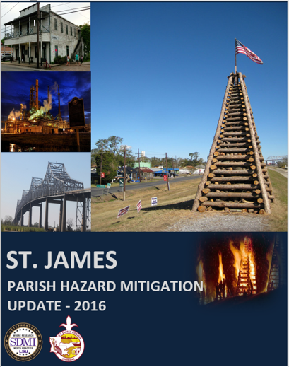

Plan
Development

Slide 11
Plan Layout
Section 1: Introduction
  Updated demographics
  Economics
  Update parish/jurisdiction descriptions
Section 2: Hazard Identification and Parish-wide Risk Assessment
Section 3: Capability Assessment
Section 4: Mitigation Strategies
  New actions
  Action updates
  Survey results

Slide 12
Plan Layout
Appendix A: Planning Process
Appendix B: Plan Maintenance
Appendix C: Parish Essential Facilities
Appendix D: Plan Adoption
Appendix E: State Required Worksheets
Appendix F: Floodplain Management/CRS

Slide 13
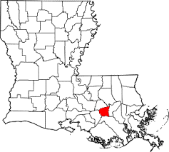
Section 1: Introduction
Updated demographics
  Census information
Economic update
  New facilities or companies that are leading to economic impact to the parish?
Parish/Jurisdiction descriptive updates

Slide 14
Section 2: Hazard Identification and Risk Assessment
Based on currently profiled risks
Any newly identified risks
Prevalent Hazards
Previous occurrences
Probability of future events
Assets Inventory
Essential Facilities
Hazard Impact
Future Development
Future Hazard Impacts
Zoning and Land Use
Hazard Profiles

Slide 15


Section 2: Hazard Identification and Risk Assessment (Previous Update)
Flooding
Tropical Cyclones
Tornados
Thunderstorms
Drought
Wildfires
Winter Storms
Subsidence/Coastal Land Loss
Expansive Soils
Sinkholes

Slide 16
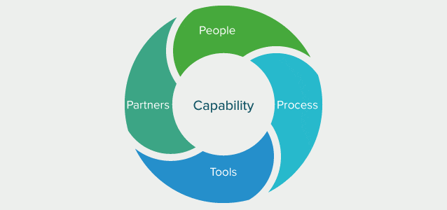
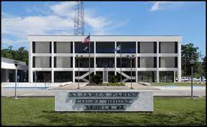
Section 3: Capabilities Assessment
Primary types of capabilities for reducing long-term vulnerability through mitigation planning are:
Planning and regulatory
Administrative and technical
Financial
Educational and outreach
Notes:
Planning and regulatory—have there been any changes in planning and regulatory polices of jurisdictions since 2010 the may effect mitigation efforts. Has there been a parish or city master plan developed/revised since the HMP plan was adopted?
Administrative and technical—who does the city/parish have on staff with skills and tools that can be used in mitigation planning? GIS team, flood plain manager, grant writers…
Financial—FEMA mitigation funds are dwindling. Does the city/parish have access to other sources for mitigation projects?
Education and outreach—what city/parish programs already exist that mitigation messaging can be incorporated into?

Slide 17
Section 4: Mitigation Strategy
Goals
1) Identify and pursue preventative measures that will reduce future damages from hazards.
2) Enhance public awareness and understanding of disaster preparedness.
3) Reduce repetitive flood losses in the parish.
4) Facilitate sound development in the parish to reduce or eliminate the potential impact of hazards.
5) Maintain and continue to improve Community Rating System (CRS) ratings throughout the parish.
Notes:
Must have two actions per hazard
Actions will fall under:
1. Local plans and regs
2. Structure and Infrastructure
3. Natural systems
4. Education and Awareness
Ex: Education and awareness may be one action that covers all hazards
The plan should be updated with the status current mitigation strategies
Progress on the mitigation action items will be monitored and evaluated by the plan administrator. The administering agency for each mitigation action is responsible for providing a quarterly status report to the plan administrator detailing the progress.
The steering committee should identify any new strategies for their jurisdictions and work together to prioritize the updated list.

Slide 18
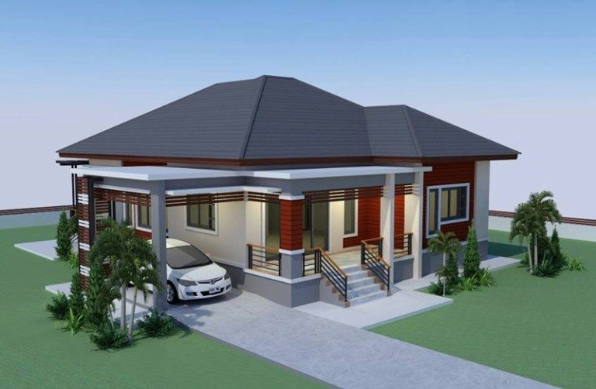
Section 4: Mitigation Action Update and New Mitigation Actions
Mitigation Action Update on old actions/projects
New Mitigation Actions Identification for 2021 Update for each jurisdiction
** We will discuss Mitigation Actions
with the steering committee at a later date.
Mitigation Action Update
Jurisdiction-Specific Action | Jurisdiction | Status
Construction of emergency shelters | St. James Unincorporated | Completed (one shelter)
Future development building standards improvements; Improve building standards by adopting the current International Building Codes by ordinance, which would result in additional techniques to harden structures. | St. James Unincorporated | Completed
Develop a master drainage plan which will evaluate drainage projects at major drainage laterals to determine best method of increasing drainage capacity. Implement recommended projects resulting from drainage plan; Improve drainage by adding new drainage pumps, enlarging culverts, replacing/improving any substandard bridges, and other drainage projects where necessary. | St. James Unincorporated, Town of Gramercy, Town of Lutcher | Ongoing
Implement mitigation measures that will alleviate road erosion within the parish. | St. James Unincorporated | Ongoing

Slide 19

Appendix A: Planning Process
Overview of planning process
Meeting documentation and summaries
Discussion of integration of neighboring community participation
Discussion of integration of other parish and jurisdiction plans to the HM Update
Steering committee members identified
Appendix B: Plan Maintenance
Review of HM plan annual maintenance by the St. James Parish OHSEP Director.
Assign responsible parties for review and edits of the plan
Notes:
Must have two actions per hazard
Actions will fall under:
1. Local plans and regs
2. Structure and Infrastructure
3. Natural systems
4. Education and Awareness
Ex: Education and awareness may be one action that covers all hazards
The plan should be updated with the status current mitigation strategies
Progress on the mitigation action items will be monitored and evaluated by the plan administrator. The administering agency for each mitigation action is responsible for providing a quarterly status report to the plan administrator detailing the progress.
The steering committee should identify any new strategies for their jurisdictions and work together to prioritize the updated list.

Slide 20



Appendix C: Essential Facilities
Updated list of essential facilities by jurisdiction
Will identify which hazards within the risk assessment pose a threat to each facility
Facilities must be parish or city owned
Notes:
Must have two actions per hazard
Actions will fall under:
1. Local plans and regs
2. Structure and Infrastructure
3. Natural systems
4. Education and Awareness
Ex: Education and awareness may be one action that covers all hazards
The plan should be updated with the status current mitigation strategies
Progress on the mitigation action items will be monitored and evaluated by the plan administrator. The administering agency for each mitigation action is responsible for providing a quarterly status report to the plan administrator detailing the progress.
The steering committee should identify any new strategies for their jurisdictions and work together to prioritize the updated list.

Slide 21
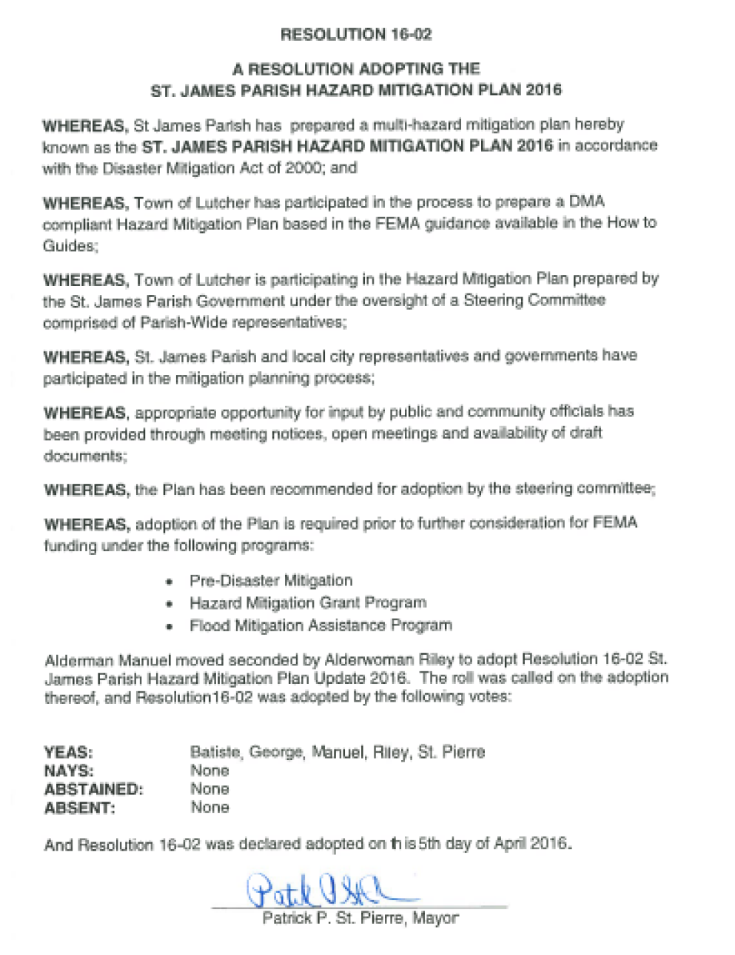
Appendix D: Plan Adoption
Parish council and city council resolutions must be adopted, signed, and placed into the final planning document – AFTER the plan is issued APA.
Templates can be provided if needed
As a planning team member, be aware of the policies for your jurisdiction
Notes:
Must have two actions per hazard
Actions will fall under:
1. Local plans and regs
2. Structure and Infrastructure
3. Natural systems
4. Education and Awareness
Ex: Education and awareness may be one action that covers all hazards
The plan should be updated with the status current mitigation strategies
Progress on the mitigation action items will be monitored and evaluated by the plan administrator. The administering agency for each mitigation action is responsible for providing a quarterly status report to the plan administrator detailing the progress.
The steering committee should identify any new strategies for their jurisdictions and work together to prioritize the updated list.

Slide 22
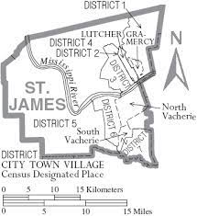
Appendix E: State Required Worksheets
Each jurisdiction MUST fill these out:
Capability Assessment
NFIP Worksheet
Critical Facilities/Building Inventory
Vulnerable Population

Slide 23
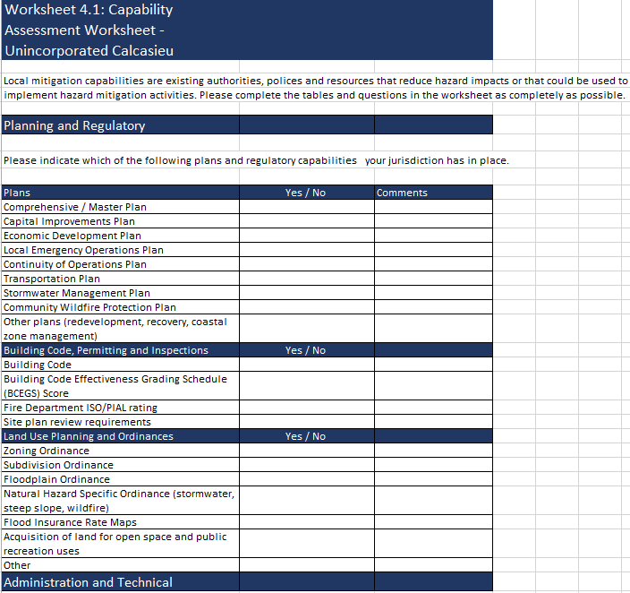
Appendix E: State Required Worksheet – Capability Assessment
St. James
Place answers in Yes/No column, add comments if necessary (i.e. what year the plan was updated last)

Slide 24
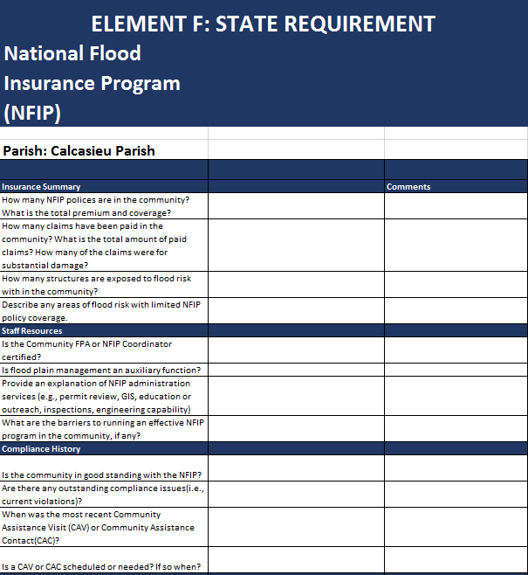

Plan Update Worksheet – NFIP
FEMA can provide this information, or local /parish floodplain managers
St. James

Slide 25
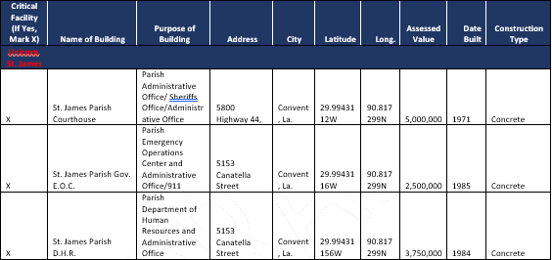
Appendix E: State Required Worksheets –
Building Inventory

Slide 26
Appendix E: State Required Worksheets –
Critical Facilities and Vulnerable Populations
St. Helena Parish
Vulnerable Populations Worksheet
St. James Parish
Name | Street | City | Zip Code | Latitude | Longitude
All Hospitals (Private or Public)
St. James Parish Hospital | 1645 Lutcher Avenue | Lutcher, LA | 70071 | 30.09343 | 90.47432
* There are no Hospitals located in the Town of XXXX
Nursing Homes (Private or Public)
Chateau St. James | 1980 Jefferson Highway | Lutcher, LA | 70071 | 30.45663 | 90.55954
* There are no Nursing Homes located in the Town of XXXX

Slide 27

Parish Mitigation Survey
Collects information from citizens regarding their perceptions of local hazards and mitigation efforts
Results will be included in the plan if there are enough responses
https://www.surveymonkey.com/r/StJamesHM2021

Slide 28
Plan Approval Process
Submit plan to GOHSEP for state review
GOHSEP submits plan to FEMA Region VI for review
Local jurisdictions adopt plan and submit resolutions
FEMA issues “approval pending adoption”
FEMA issues approval letter and final plan review tool
The plan will be subject to revisions as it moves through the review process.

Slide 29
The Final Product
FEMA approved Hazard Mitigation Plan
  Meets requirements of Title 44 Code of Regulations (CFR) §201.6 for approval and eligibility to apply for FEMA Hazard Mitigation Assistance grant programs.
  A hazard mitigation project strategy for each jurisdiction
  A comprehensive list of jurisdiction owned properties
  Assessment of natural disaster-related risks and vulnerabilities

Slide 30
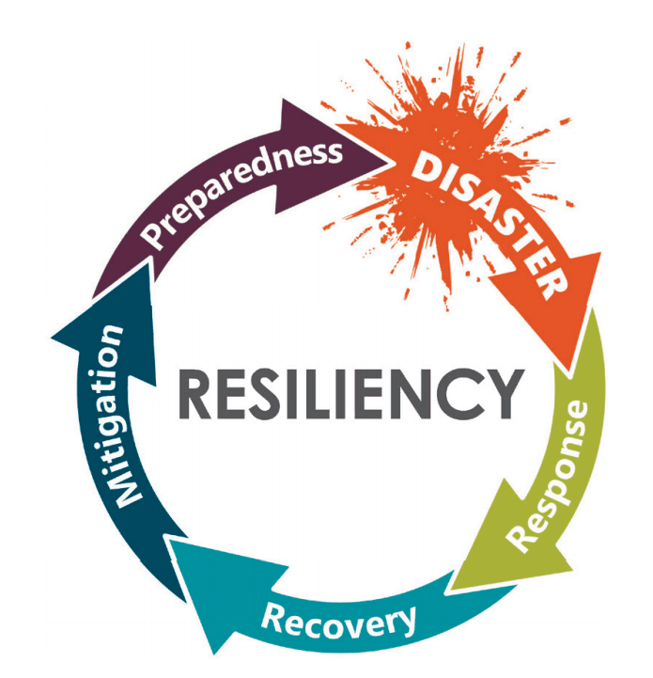
Next Steps
Worksheet and Mitigation Action due dates?
Identify Neighboring Community
Next meetings?
  Mitigation Action Workshop (Optional)
  Risk Assessment Review with Committee
  Public Meeting
Draft Plan to Parish/FEMA
  After the public meeting
Adoptions
  AFTER the FEMA Review!!!

Slide 31
Contact Us
Brant Mitchell, SDMI Director, CEM
bmitch9@lsu.edu
(225) 578-5939
Lauren Stevens, Associate Director, MEPP
lstevens@lsu.edu
(225) 578-0502
Chris Rippetoe, HM Project Manager, CFM
crippe2@lsu.edu
(225) 578-6667
Anna Daigle, Emergency Management Specialist
adaig35@lsu.edu

Slide 32


